Slide 1
ADAPTIVE HCI
Real-time Stabilization and 3D Reconstruction of Hand Gestures and Finger Movements Trace using LED-Equipped Gloves
Presented by Team 5: Deniz Acikbas, Soham Naik, Zaynab Mourtada, Alan Raj

Slide 2
Project Overview
Objective: Develop a mobile, real-time proof-of-concept to validate the technical feasibility of Dr. Zhang’s RoFin pipeline on consumer-grade hardware.
Approach:
Designed a smartphone-based system for tracking LED-equipped fingertips, using YOLO.
Used multi-stage filters for motion path smoothing.
Classified gesture paths using CNN models.
Core Question: Can advanced 3D gesture tracking work reliably on a mobile device outside the lab?

Slide 3
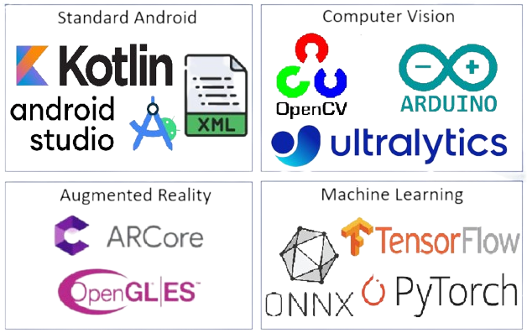
Technologies Used

Slide 4
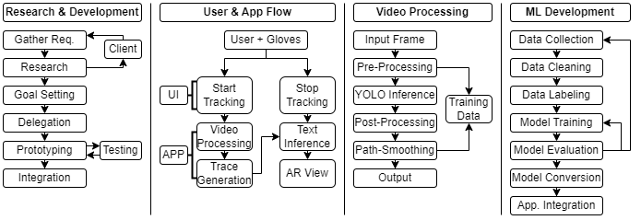
Project Workflows

Slide 5
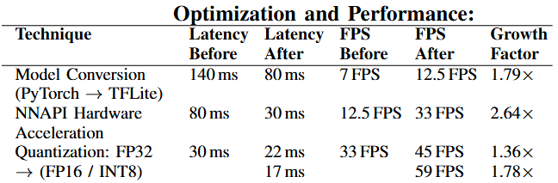
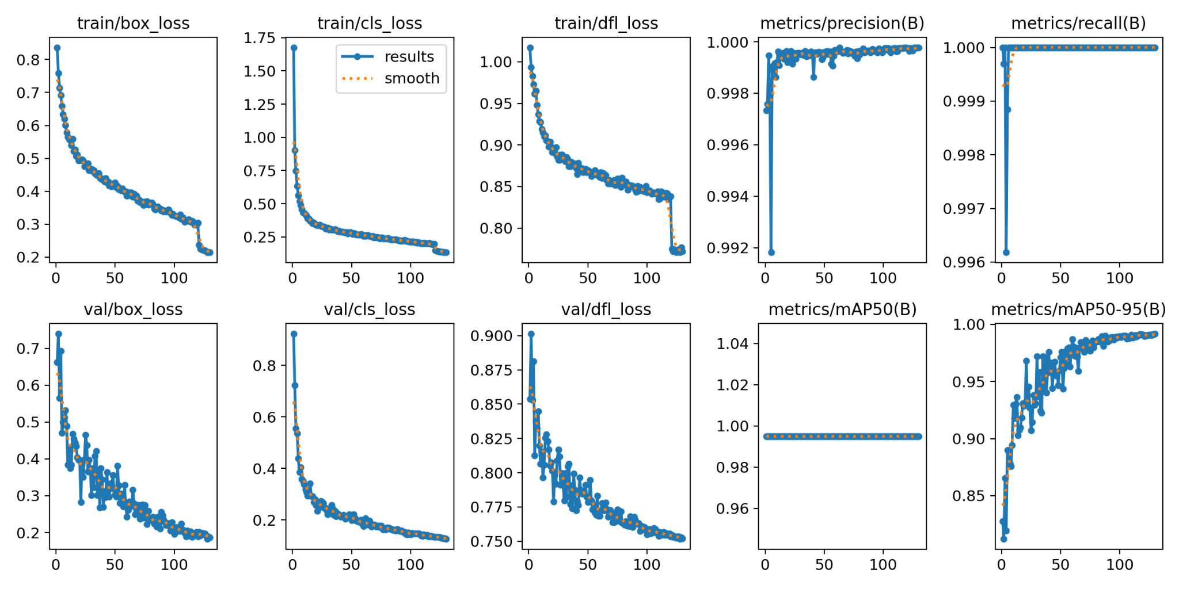
Results & Performance Evaluation
High Real-Time Performance
Achieves over 33 FPS on Google Pixel 8A
Optimized System
Full Hardware Utilization
Accuracies
99.8% YOLO 99.6% CNN - Digit 96% CNN - Letter
High precision, recall, and mAP with low validation loss
Model Training
Indicates a robust, well-trained model ready for real-time high accuracy tracking

Slide 6

Real-World Applications
Seeing the Future
Who Will Benefit
Real-time 3D gesture tracking on phones.
Touch-free input using LED-guided fingertip tracking.
Healthcare: Hands-free control for patients
AR/VR: Multi-user interactions
Tech: Next-gen human-computer interaction
What’s Next
Why It Matters
Support more devices and improve accuracy
Make gesture recognition more reliable.
Touch-free input for people with motor impairments.

